Slide 1
Duel of Wits
Joshua Boone and Chase Perdue

Slide 2
Introduction
Overview
Welcome
Game Inspiration
AI Techniques
Program Structure
What We Learned
Demo

Slide 3
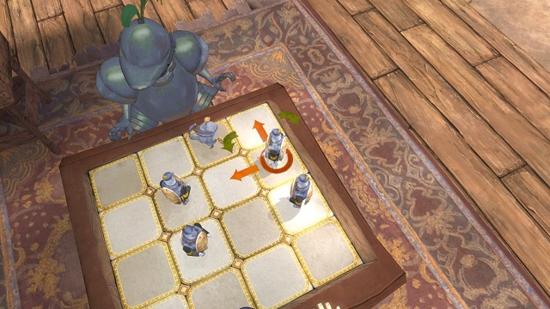
Game Inspiration
King’s Quest 2015 minigame
Turn-based gameplay
Simplified rules
4x4 board

Slide 4
Game Elements
Player Piece
X 2
Reflecting Piece
X 4

Slide 5
Starting Position

Slide 6
Fewest Potential Moves Ply
7 Possible moves
9 Possible moves

Slide 7
Most Potential Moves Ply
23 Possible moves
23 Possible moves

Slide 8
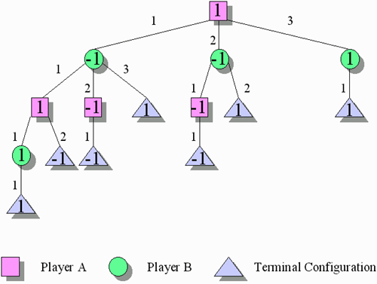
AI Techniques
Minimax Variant
Game Tree
Nodes of GameStates
Value Assigned
Heuristic + Sub-Heuristic
(Chase: pronounced hyoo-ris-tik!)
A-B Pruning

Slide 9
Alpha Beta Tree Size for Single Ply
. . . X 9
. . . X 23
. . . X 7
. . . X 23
Least Potential Leaves
9 x 7 = 63
Most Potential Leaves
23 x 23 = 529

Slide 10
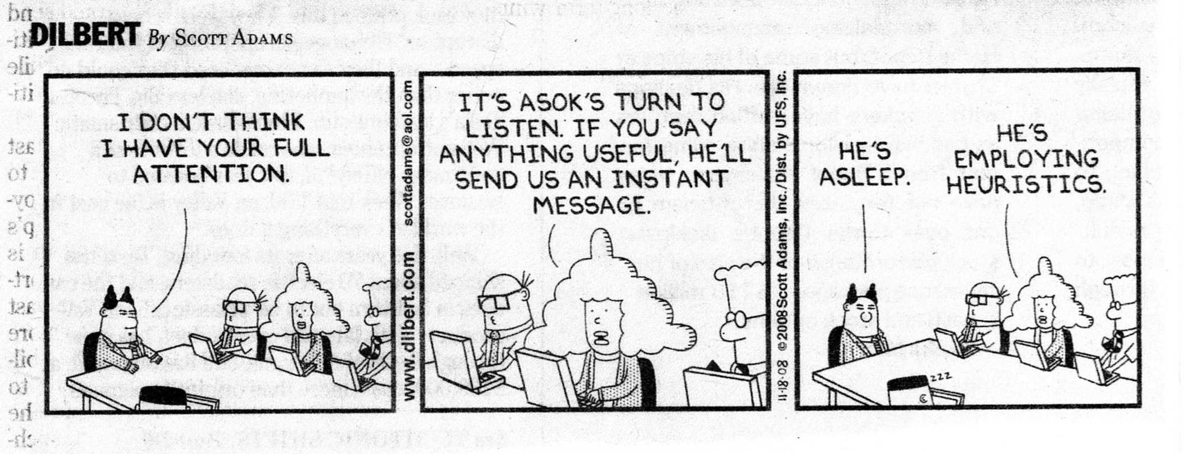
AI Techniques 2
Heuristics Discussion
The Heart of the Problem
Silent Rage
Handsome Bearded Presenters
??
Profit.

Slide 11
Heuristic
P1
M1
M3
M2
M4
P2

Slide 12
Heuristic
Compare row first
P1
Compare column first
M1
M3
M1
M3
M2
M4
M2
M4
P2

Slide 13
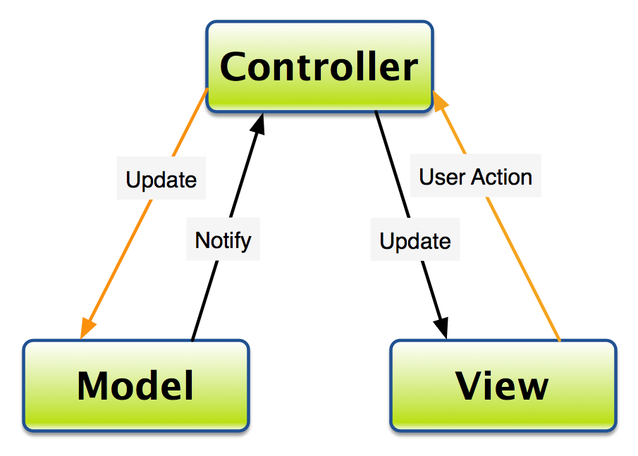

Program Structure
Model View Controller (MVC) architecture
Keep User and Data separated
Aided with organization of classes
Good Practice
Extensible, Modular
Java Programming Language
Safe
Convenient

Slide 14
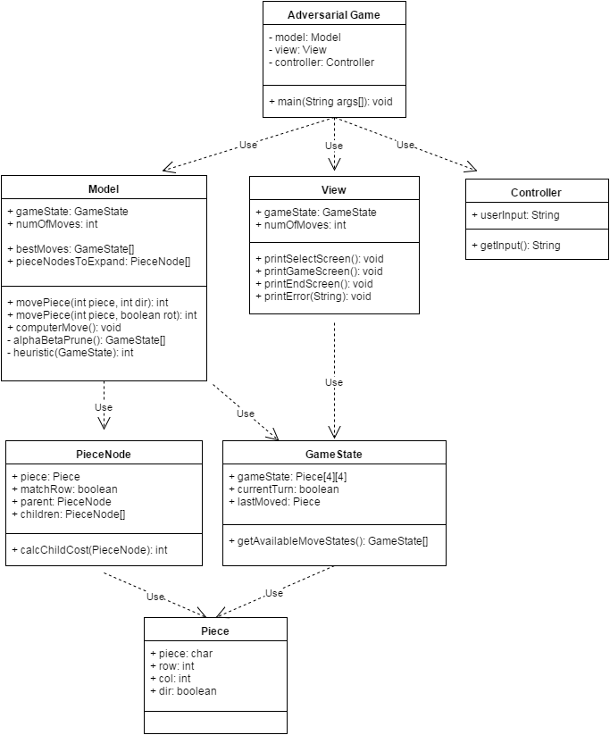

Slide 15
What We Learned
Heuristics are important
AI is great at solving modeled problems
MVC is better at organizing small programs than I thought!

Slide 16
Demo
Thank you for your attention.
Image Credits:
java.net (minimax + logo)
gry-online.pl (King’s Quest)
web.stanford.edu/~msirota/soco/alphabeta.html (Animation)
Stackoverflow.com (MVC)
Dilbert.com (comic)

